Slide 1
Introducing Graphics to the Visually Impaired One Pixel at a Time

Slide 2
Introduction
Goals
Demonstrate tool
Graphics Insight
Raise Awareness

Slide 3
Presentation Background
I'm a programmer / teacher
Pictures – powerful tools
Blind - limited tool access

Slide 4
Viewing Problems
Programming Tools not geared to the visually impaired
Tools - expensive/cumbersome
Expensive, noisy, slow
Shared, in another room

Slide 5
The Tool
Initial goal: Help beginners learn Programming
Extended goal: Graphics for Visually Impaired

Slide 6
Tool Provides
Braille rendition of simple program graphics
Graphics output with audio feedback
Notes:
Compromises: Lower resolution, Few colors

Slide 7
A Non-programming view
Python program
a wordy nerdy "Etch A Sketch" drawing tool
Drawing Instructions

Slide 8
Simple Program - draw a square
# square_loop_colors.py
# Display a multi-color square
from turtle_braille_link import * # graphics
width(40)
colors = ["red", "orange", "yellow", "green"]
for clr in colors:
color(clr)
forward(200)
right(90)
done() # Complete drawing
Notes:
We don't like possible confusion by re-using turtle.py name.

Slide 9
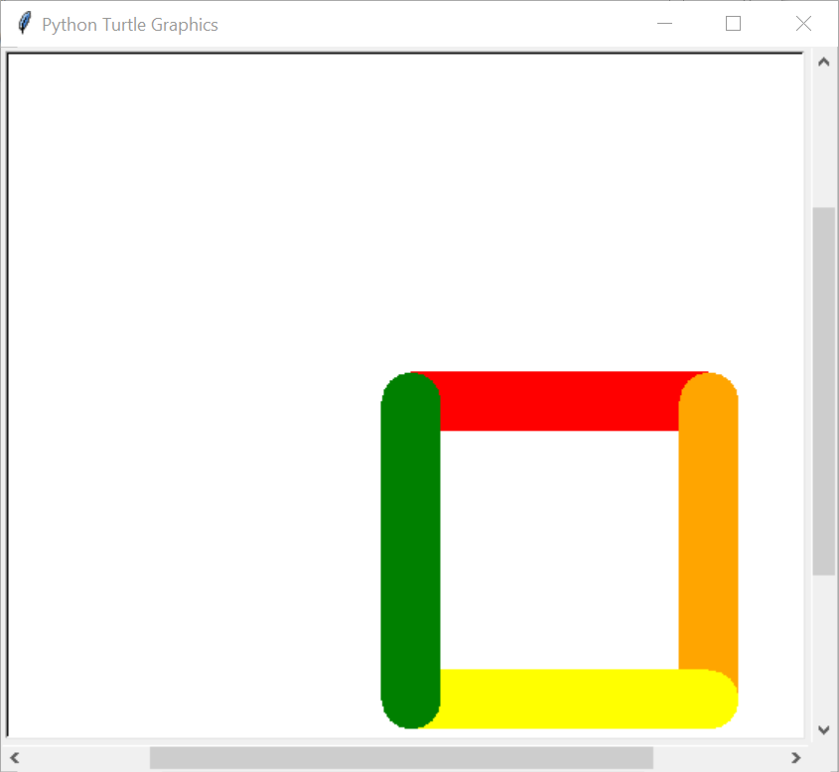
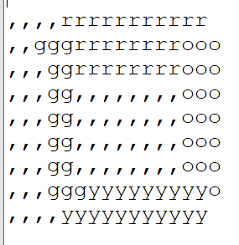
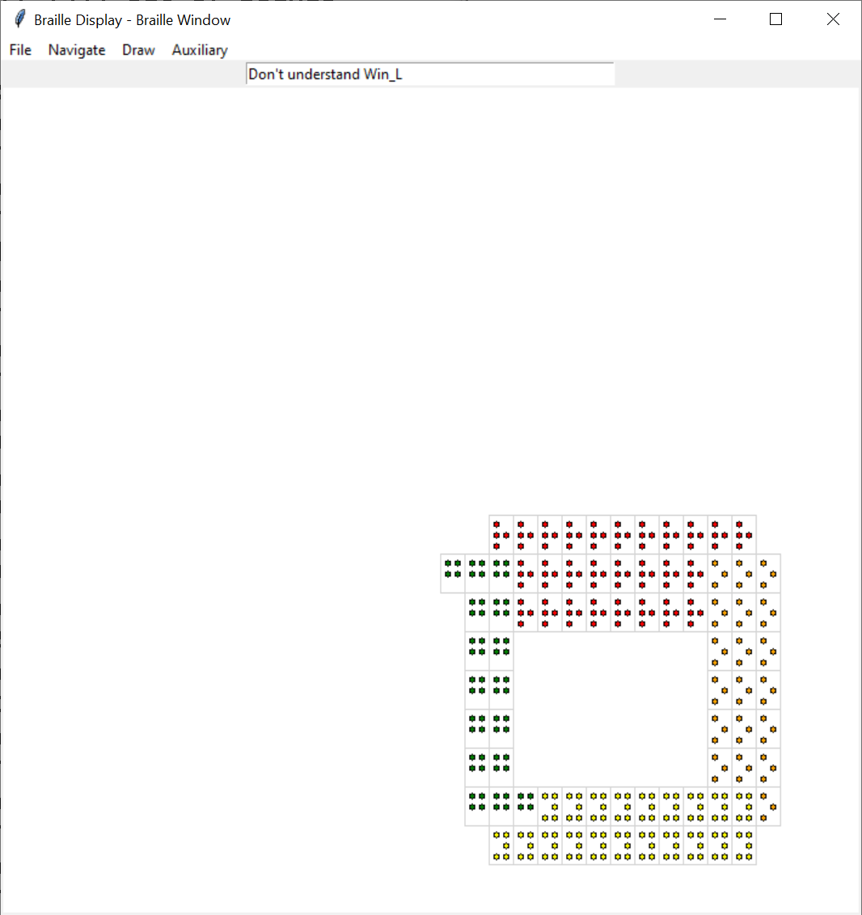
Tool Output
Notes:
Braille display widow started as a guide to the implementor
Became an audio based guide

Slide 10
Changes to Braille text
Spaces to commas
Braille machine compresses multiple spaces
Comma Braille:
Moving figure up to left
Facilitate finding figure

Slide 11
A Demo – Hopefully Live
Following slides are reminders
offline viewing
If computer problems
Demo V/I usage…
cmd> cd Desktop\...\01_intro
cmd> python square_loop_colors.py
Notes:
Students copy files to Desktop\braille_2023\
Simplest graphics square.py, square_loop.py

Slide 12
Braille usage steps
Copy text
Transmit to Braille embosser
Retrieve paper
Slows viewing → reduces impact

Slide 13
Hope: quick change and quick view
square_loop.py
square_loop_w40.py – thicken lines
square_loop_colors.py – add colors

Slide 14
Audio Feedback – Demo
Notes:
Started as a guide to the implementor
Became an audio based guide

Slide 15
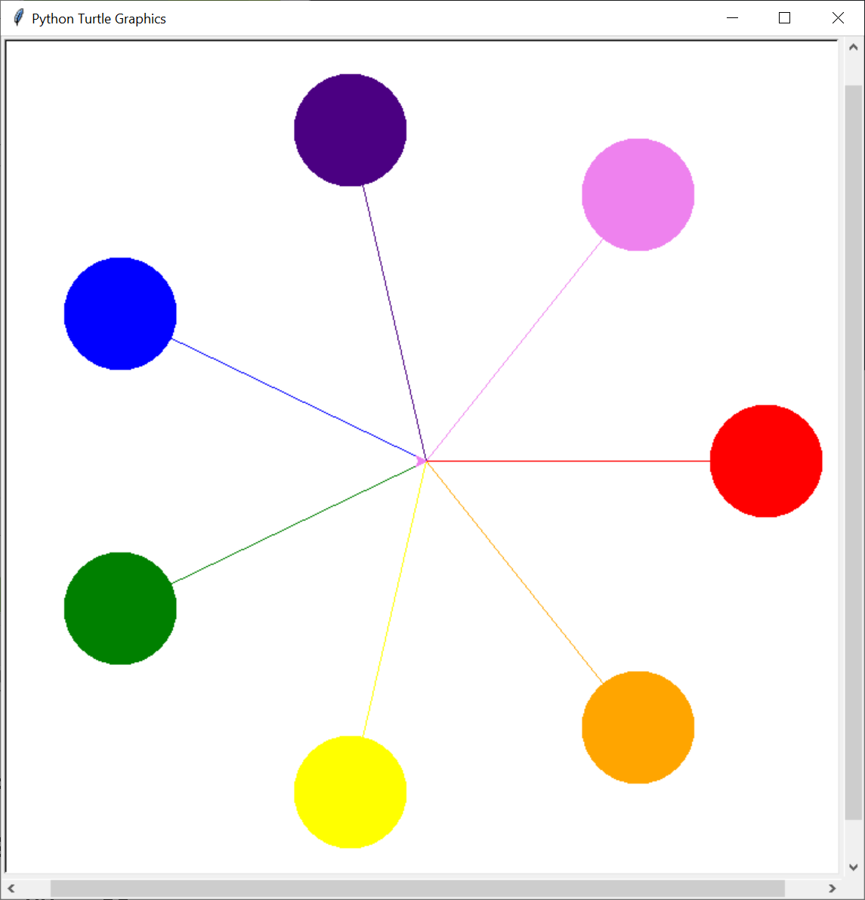
Spokes – A More elaborate figure

Slide 16
Spokes text output
,,,,,,,,,,,,,iii
,,,,,,,,,,,,iiiiii
,,,,,,,,,,,,iiiiii,,,,,,,,vvv
,,,,,,,,,,,,iiiii,,,,,,,vvvvvv
,,,,,,,,,,,,,,,i,,,,,,,,vvvvvv
,,,bbb,,,,,,,,,ii,,,,,,,,vvvvv
,,bbbbb,,,,,,,,,i,,,,,,vvv
,,bbbbbb,,,,,,,,i,,,,,vv
,,bbbbbbbb,,,,,,ii,,,vv
,,,,,,,,,,bbbb,,,i,,v,,,,,,,,,,,rr
,,,,,,,,,,,,,bbbbivv,,,,,,,,,,rrrrrr
,,,,,,,,,,,,,,,,bvvrrrrrrrrrrrrrrrrr
,,,,,,,,,,,,,ggg,yoo,,,,,,,,,,rrrrrr
… Omitted for brevity …

Slide 17
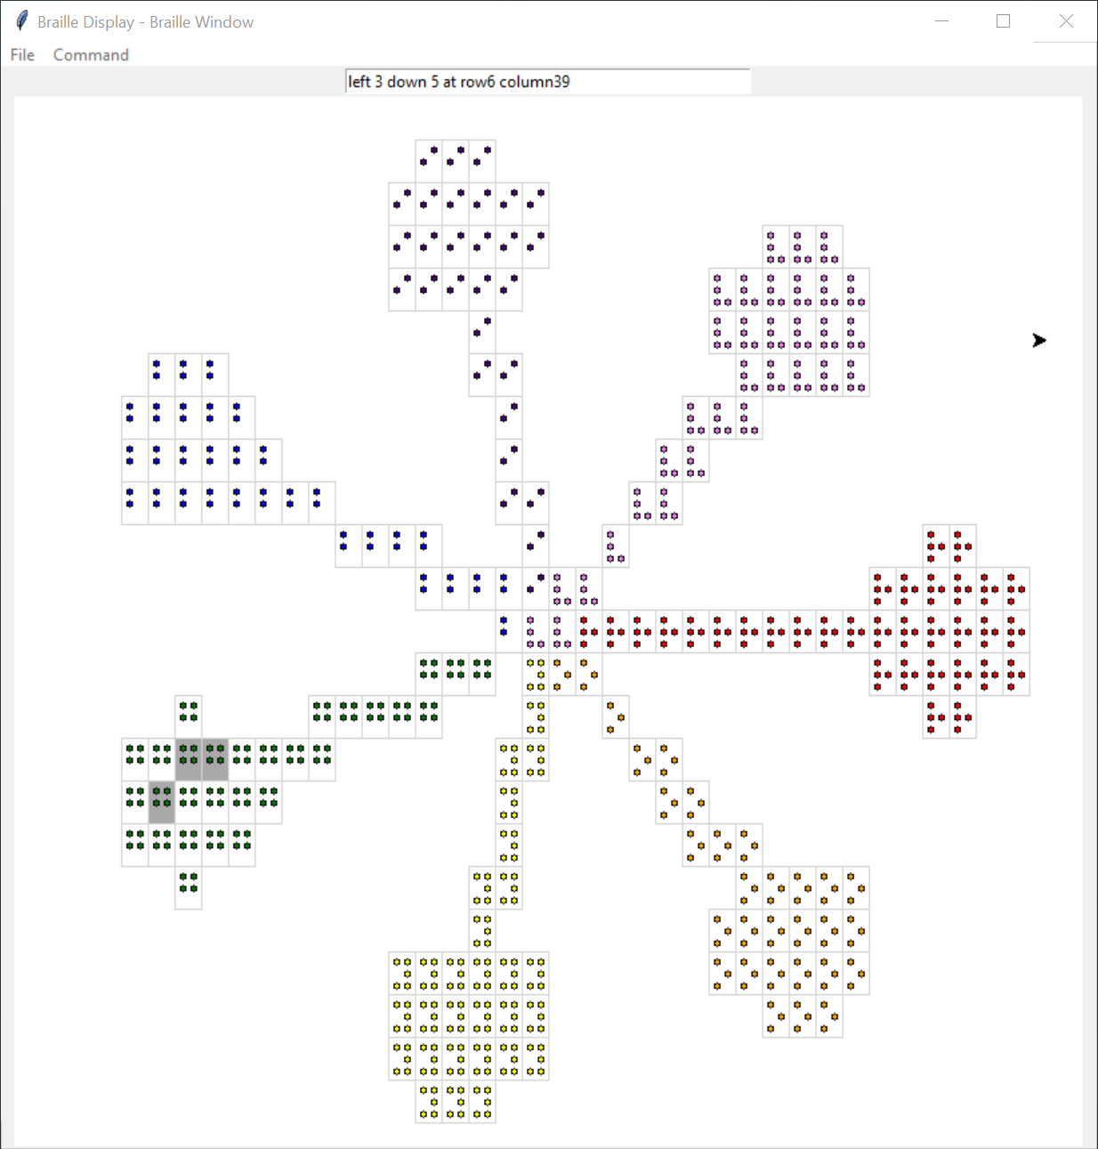
Spokes – Braille Display

Slide 18
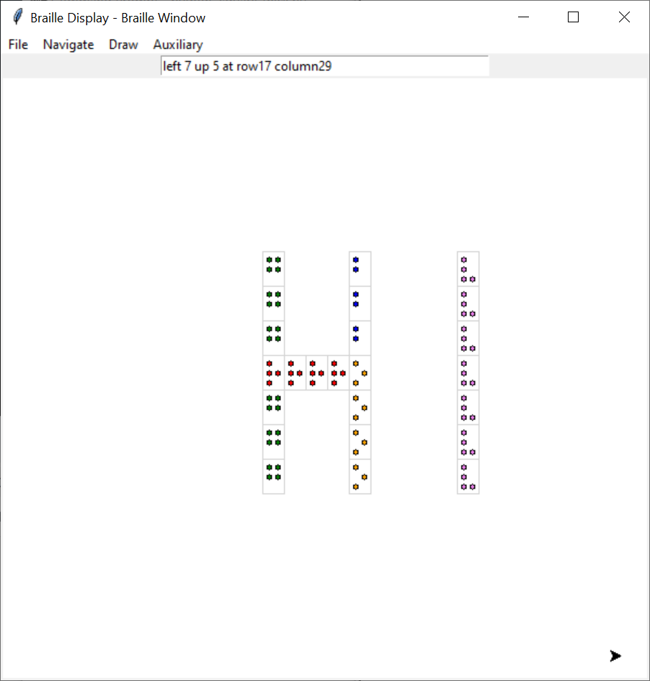
A Drawing Tool
Braille Text
,,g,,,b,,,,v ,,g,,,b,,,,v ,,g,,,b,,,,v ,,rrrro,,,,v ,,g,,,o,,,,v ,,g,,,o,,,,v ,,g,,,o,,,,v

Slide 19
Future Possibilities
Navigational Improvements
Speedups – async audio
Stereo audio feedback, distance, direction, feedback
More intelligent/automatic scanning
Presentation Improvements
Real-time scaling region maginification / selection

Slide 20
Question and Answer

